Slide 1
BATTLE OF NEIGHBORHOOD
Capstone Project
FINDING A SAFE HOME IN LONDON
Sreenath Gangadharan
July 2020

Slide 2
Introduction
Problem
In today’s world Safety is the biggest concern when choosing a community or place to live. Almost all others are secondary and may be little bit adjustable. And we will be trying to find out the Safest Area or Borough in London
  Background
One of my elderly friends approached me to help him in suggesting a safe area for his family to settle down. He had done basic research and feels that safety must be given the most priority.
I choose it as an opportunity to do some research on crime records of London and analyze the data available to find out the safest borough so that it can help him with a good suggestion and to use the model again for future reference
  Interest
At the end of this analysis this will help with anyone who tries to identify the safest borough in London and will help to explore a little bit on the communities and the amenities nearby.

Slide 3
Data Acquisition and Cleaning
Data Used and Source
London Crime Data
List of London Boroughs
List of districts in the Royal Borough of Kingston upon Thames
London Crime Data
London crime data shows the crime per borough in London is taken from Kaggle
.
List of London Boroughs
List of London boroughs is scrapped from the wiki page, this page contains additional information about the boroughs
List of districts in the Royal Borough of Kingston upon Thames
List of districts in the Royal Borough of Kingston upon Thames is wiki page

Slide 4
  Data Cleaning
From the London crime data, the crimes during the year 2016 is only selected. The major categories of crime are pivoted to get the total crimes per borough as per the category.
Beautiful Soup Library is used to scrap List of London boroughs of wiki to obtain borough details. Many string manipulation and removal is required to obtain data in desired format.
These two datasets are merged to on Borough Names to get all the required information inside a single dataset , which can help us visualize crimes count against each borough so that we can find which borough has highest and which have lowest crimes against them
Then we will create the third dataset from List of districts in the Royal Borough of Kingston upon Thames using pandas and set the Neighborhood and will fill the latitude and longitude from geocoding API
Then we will use this dataset to generate venues of each neighborhood using FourSquare API

Slide 5
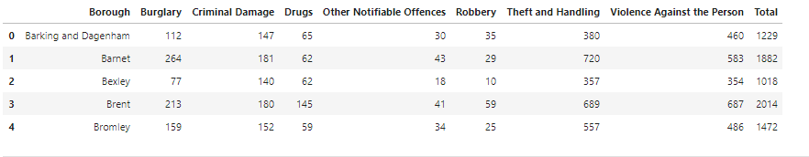
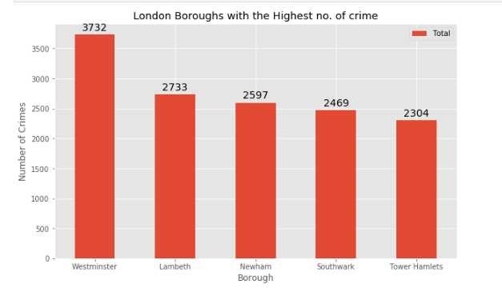
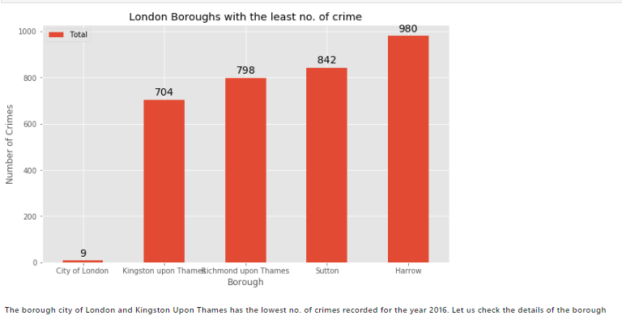
Methodology
Explanatory Data Analysis
Crime data analysis

Slide 6
Neighborhood Analysis
Collected the data of all 15 Neighborhoods Royal Borough of Kingston Upon Thames of from the wiki
Added Latitude and longitude to the dataset using geocoder
Modelling
We used foursquare API to find all the venues within 500 meter radius of each neighborhood of Royal Borough Kingston upon of Thames

Slide 7
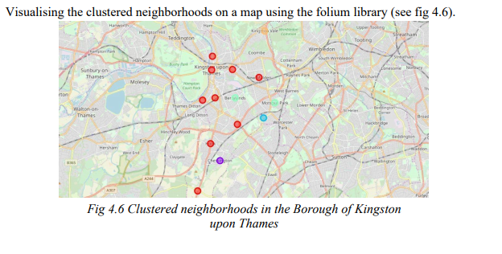
Clusters

Slide 8
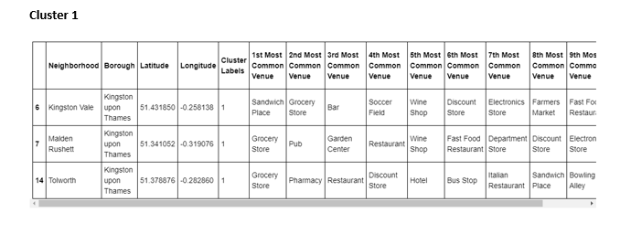
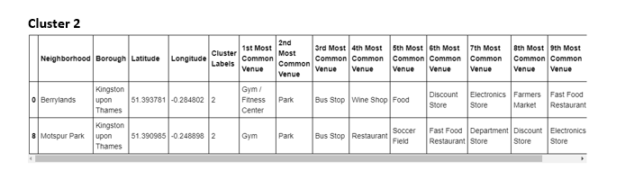
Most Common venues in Clusters

Slide 9
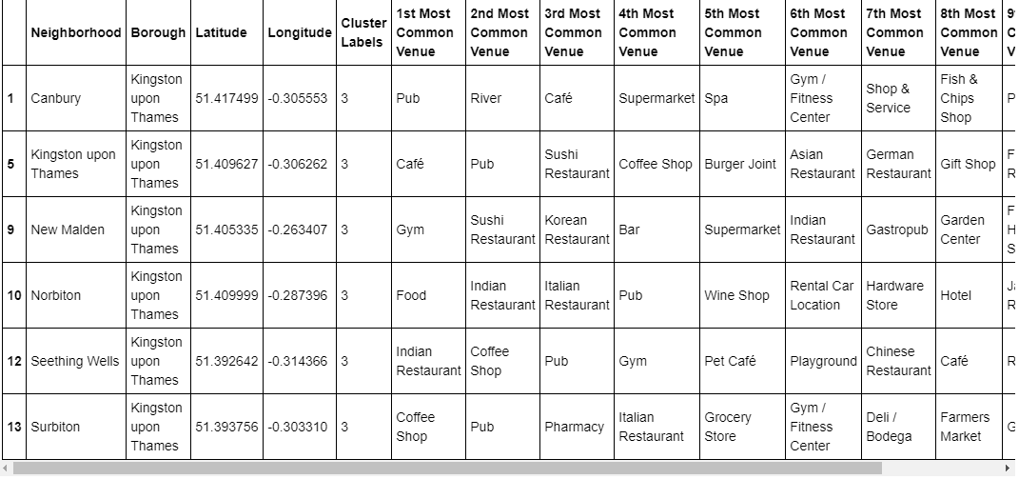
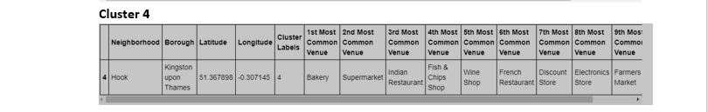

Slide 10
Results and Recommendations
This aim of the project was to find the safest borough and to determine the best neighborhood in that Borough, We had done the research with the available information and provided 4 clusters . the user can easily select from the above clusters
Recommendations are just based on the data and doesn't consider the personal preferences and sentiments
If you are considering public transport and entertainment, then cluster 2 is recommended
If you are considering an area with good restaurants, pubs and bar cluster 3 is recommended

